Slide 1

FACE MASK DETECTION
Team Member 1 : Darshan Vasoya (92200103199) 6TC-3
Team Member 2 : Raj Mungara (92200103223) 6TC-3
Team Member 3 : Rupesh Rudakiya (92200103222) 6TC-3

Slide 2
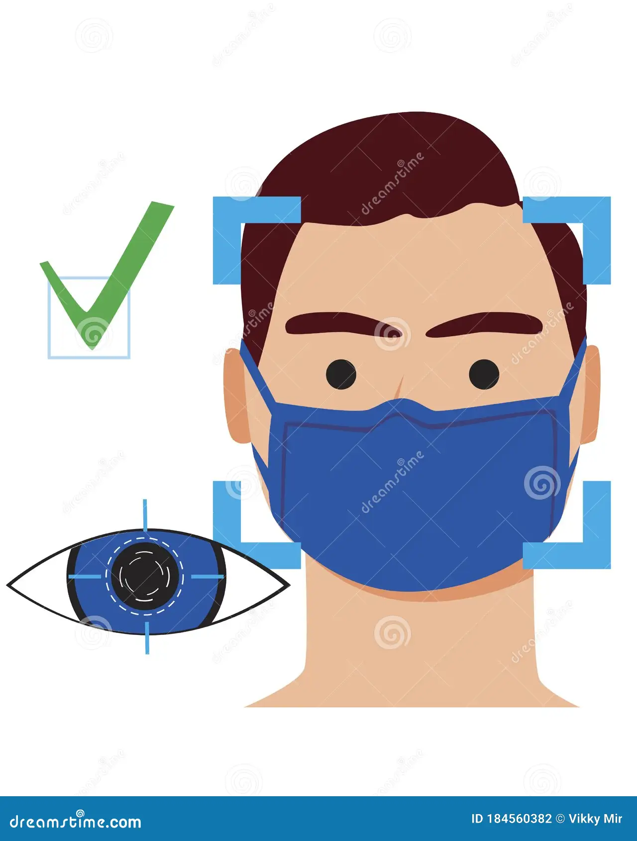
Face Mask Detection: A Computer Vision Project
This project focuses on building an automated system. It accurately and efficiently detects face masks in images and videos. The goal is to address the growing need for face mask detection in the post-pandemic world.

Slide 3


Problem Definition: The Need for Automated Detection
The global pandemic underscored the importance of face masks. Public health mandates require compliance monitoring. Manual monitoring is costly and prone to human error. An automated system ensures public safety and adherence to regulations. Mask wearing reduces spread significantly.
Challenge
Solution
Manual Monitoring
Automated System

Slide 4
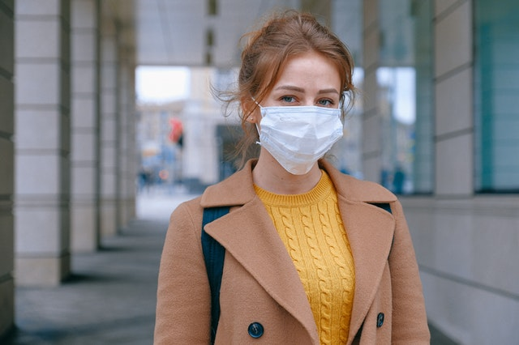

Challenges in Face Mask Detection
Detecting face masks presents several challenges. These include variations in mask types and occlusion. Lighting and pose variations further complicate detection. Computational constraints also impact real-time applications. Addressing these challenges ensures robust and reliable performance.
1
Mask Variations
Different types, colors, patterns.
2
Occlusion
Hand gestures, facial hair, glasses.
3
Lighting
Varying conditions, image quality.

Slide 5




Proposed Solution: Deep Learning with CNNs
We propose using Convolutional Neural Networks (CNNs). CNNs are powerful tools for image recognition. Transfer learning leverages pre-trained models to speed up training. Architecture selection balances accuracy and efficiency. This approach ensures accurate and fast face mask detection.
CNNs
Transfer Learning
Fine-Tuning

Slide 6

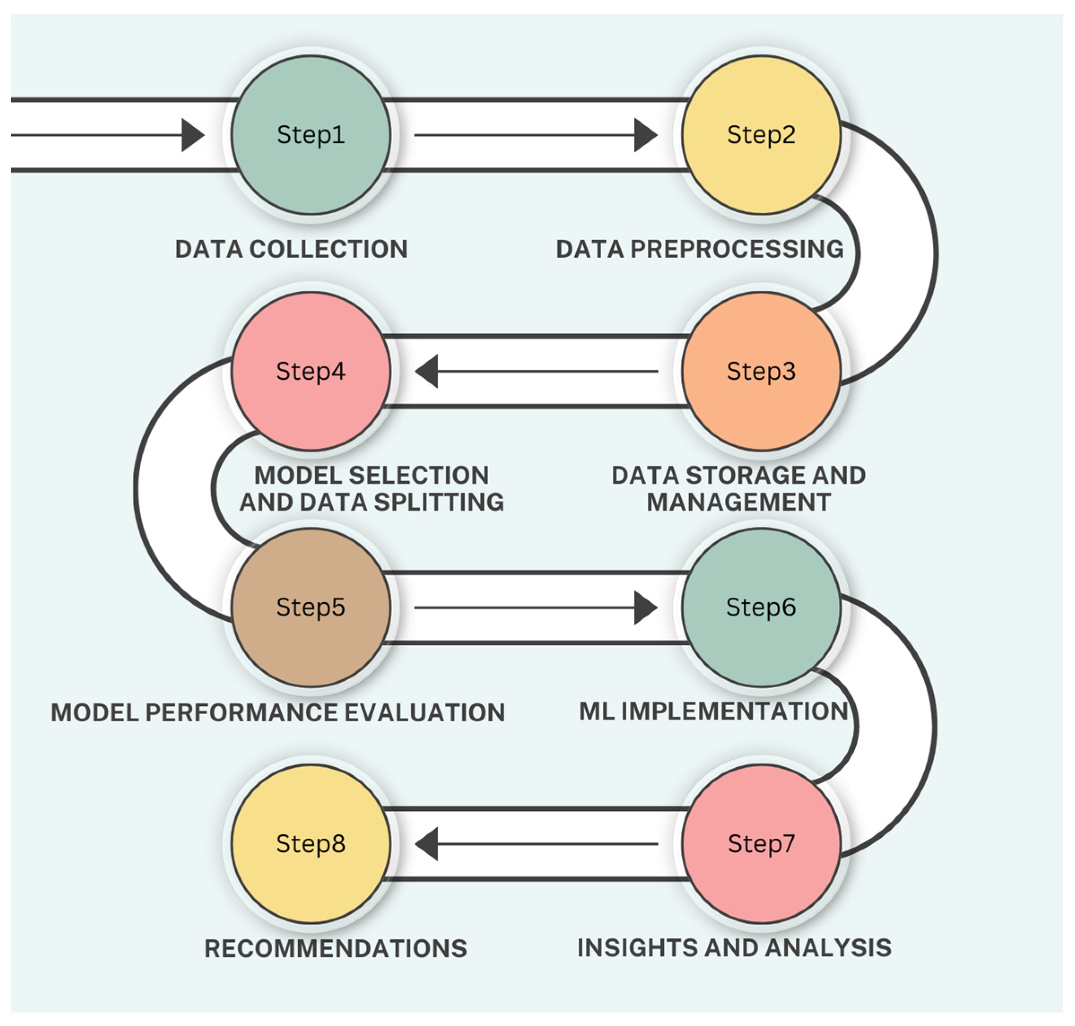
Methodology: Data Acquisition and Preprocessing
We acquire data from public datasets and web scraping. Data augmentation techniques enhance the dataset. We split data into training, validation, and testing sets. Image resizing and normalization ensure consistent input. Handling class imbalance is crucial for accurate results.
1
Data Acquisition
2
Augmentation
3
Data Splitting

Slide 7



Methodology: Model Training and Evaluation
We train the CNN model using the prepared dataset. Binary cross-entropy is used as the loss function. Adam optimizer adjusts the model's parameters during the training. Monitoring validation loss prevents overfitting. Accuracy, precision, recall, and F1-score evaluate performance.
2
Optimization
1
Training
Evaluation
3

Slide 8





System Architecture: Flowchart
The system architecture outlines the face mask detection pipeline. It starts with input images or video and detects faces. After that, preprocessing is performed and classification happens using CNN. The final step is to visualize the classification results.
Input Image/Video
Face Detection
CNN Model
Mask/No Mask
Output

Slide 9
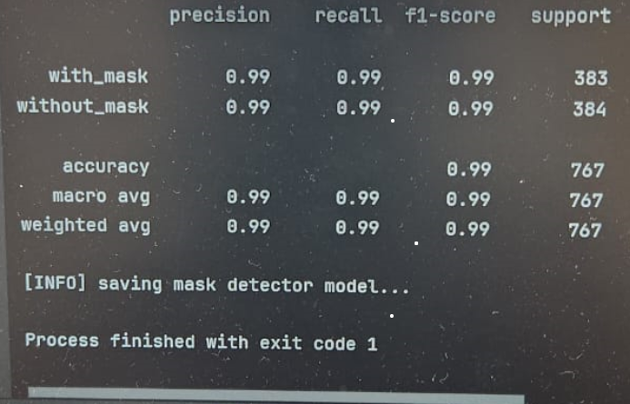
Results and Performance Analysis
We evaluate the model using accuracy, precision, recall, and F1-score. We compare results with existing methods. We also analyze failure cases and identify improvements. Benchmarking performance on different hardware helps optimize deployment.

Slide 10
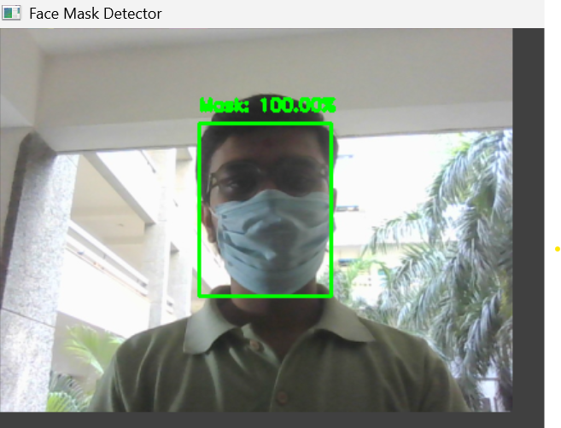
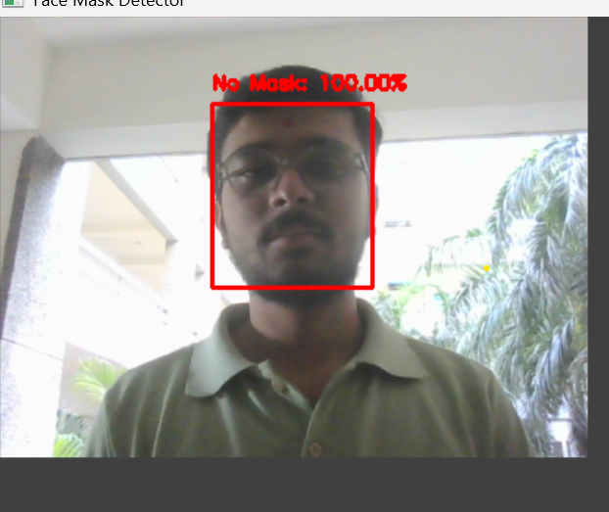
Results and Performance Analysis
This image shows a face mask detection system identifying one person wearing a mask with 100% confidence. A green box and label confirm correct mask usage, highlighting the model’s accuracy and effectiveness in real-world conditions, even with facial accessories.
This image displays a face mask detection system identifying one person without a mask, with 100% confidence. A red box and “No Mask” label indicate accurate detection, showcasing the model’s reliability even in natural lighting and with facial accessories.

Slide 11
Real-time Demonstration and Applications
A live demo showcases the face mask detection system. Potential applications include access control and public transportation monitoring. Retail stores and schools can also benefit. Ethical considerations and privacy concerns are addressed to ensure responsible deployment.
Access Control
Public Transport
Retail Stores

Slide 12
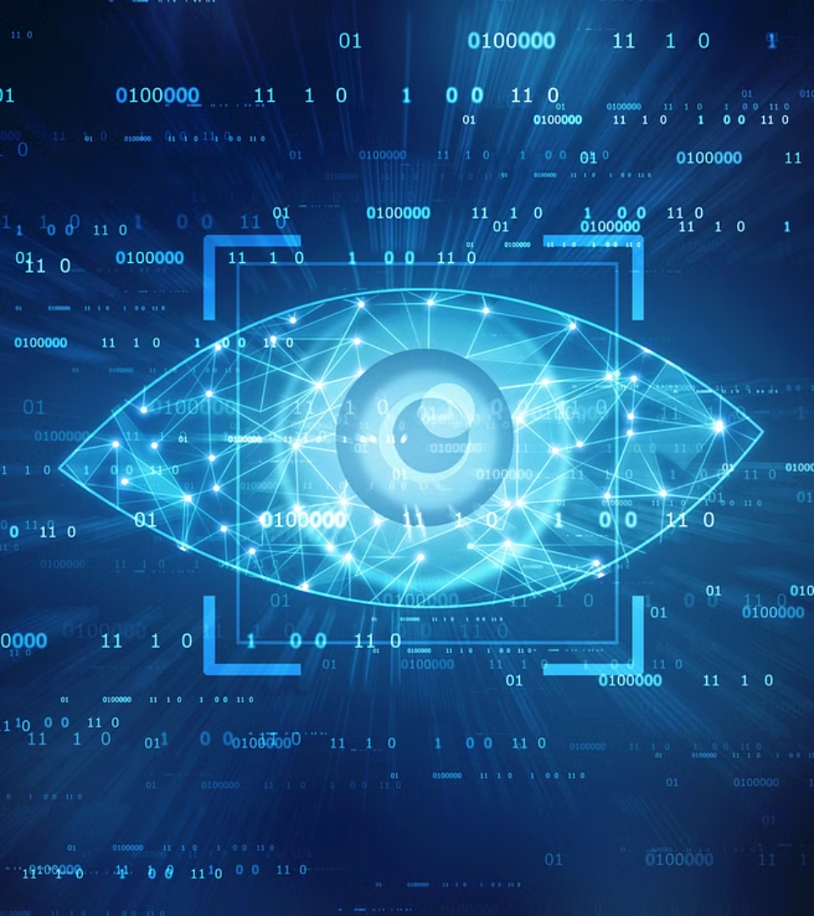
Conclusion and Future Work
This project successfully detects face masks using computer vision. Future work focuses on improving accuracy and detecting improperly worn masks. Extending the system to detect other safety equipment is also a goal. Integration with existing surveillance systems enhances its utility.
1
Improve Accuracy
2
Detect Improper Masks
3
Detect Other Equipment

Slide 13

Thank You!

